Slide 1
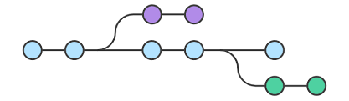
Branching and Tagging
Internal Only

Slide 2
Branches Required for Code Development
MANDATARY BRANCHES
Master
Release
Feature
(These branches are used only for final testing and releases, developers are not allowed to push code to these branches directly)
DEVELOPMENT BRANCHES
Developers are allowed to create Required number Branches and sub branches with appropriate names for code development.

Slide 3
Sample Merging and Tagging Strategy
Developers will use development branches to develop the code and push them to GitHub Repository.
After pushing the code to GitHub Repository, we run pipelines based on development branches and we test in Stage00 and STI environments.
After testing at development branch level, we merge development branches to feature branch and we run pipelines based on feature branch and we test it again.
If testing is done at feature branch, feature branch should be merged with Release Branch with appropriate tag and tested here for three to four days.
The container images generated from release branch should be used for deployment in production environments.
After successful deployment, release branch will be merged with Master branch and unwanted branches will be deleted.
The steps will be repeated again for next deployment.

Slide 4
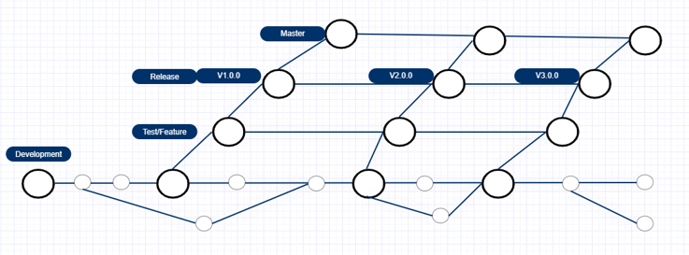
Sample Branching and Tagging Strategy

Slide 5
Sample Time Frame For Development And Deployment
If, Expected Deployment is on 5th November, 2022.
Last date for developing code and push to GitHub repository: 25th October, 2022.
Merging of branches to feature Branch: 27th October, 2022.
Merging of feature branch to release branch: 29th October, 2022.
Updating of YAML files: 4th November, 2022.
(YAML files will be updated with container image ID, Release version (tag), release date and time and any other changes if required)

Slide 6
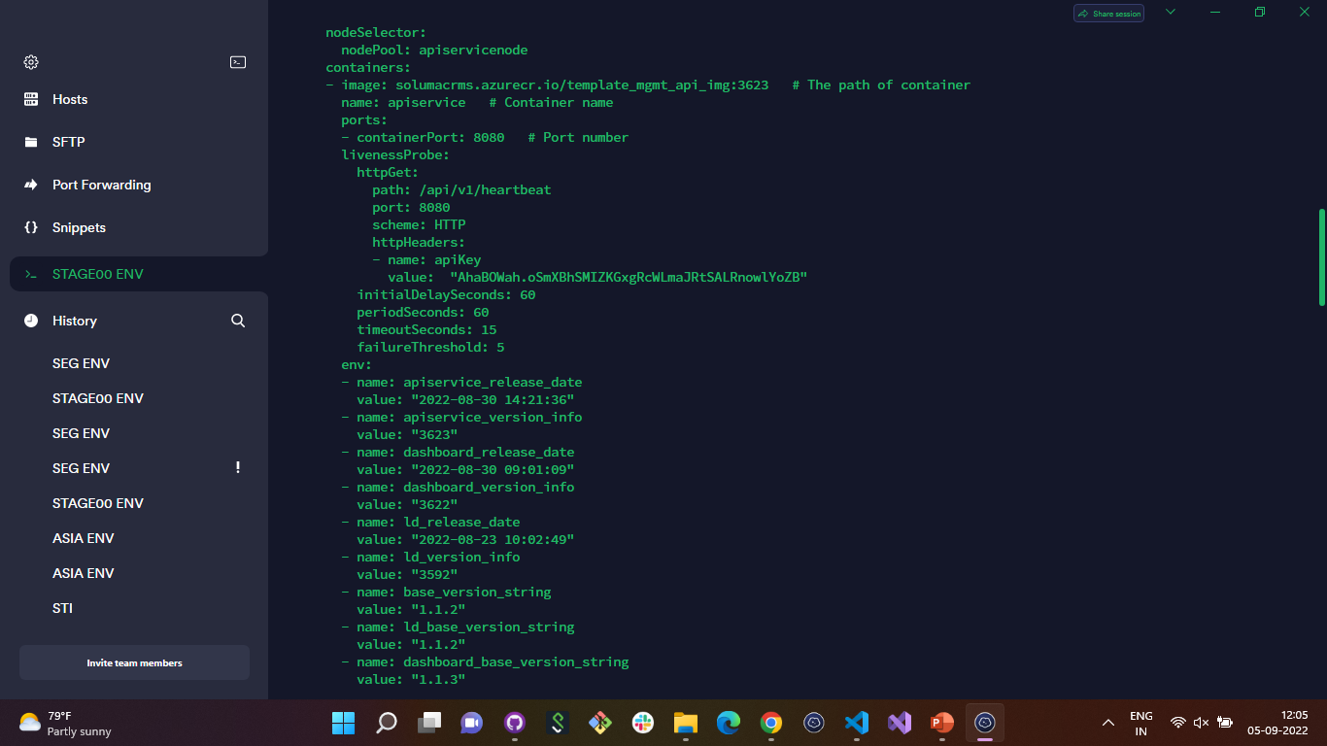
API Service YAML File

Slide 7
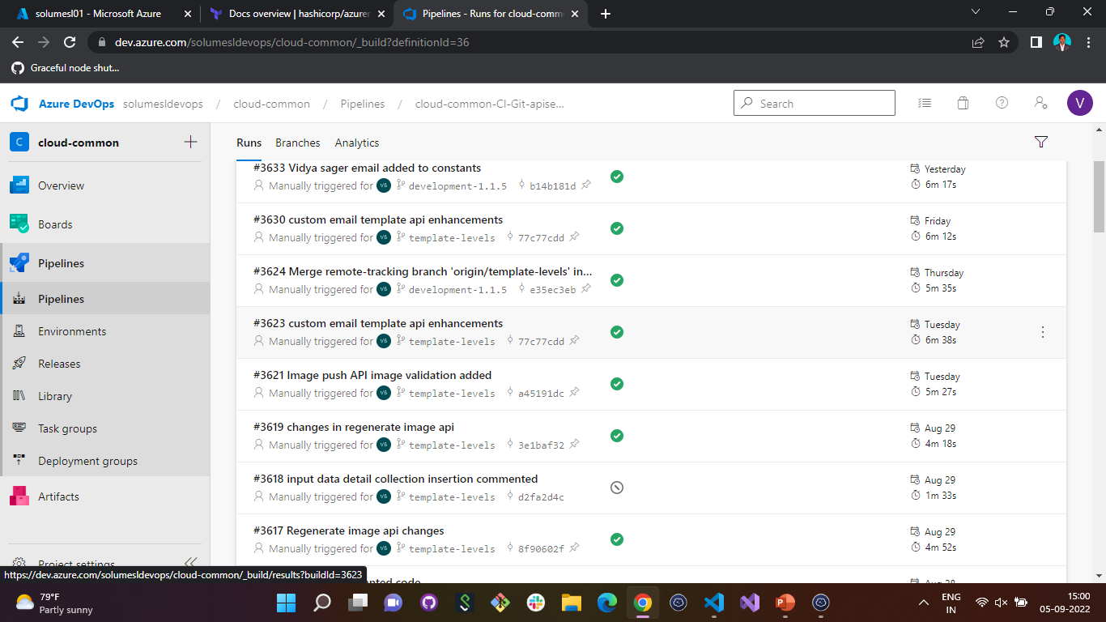
Azure Pipeline for API Service

Slide 8
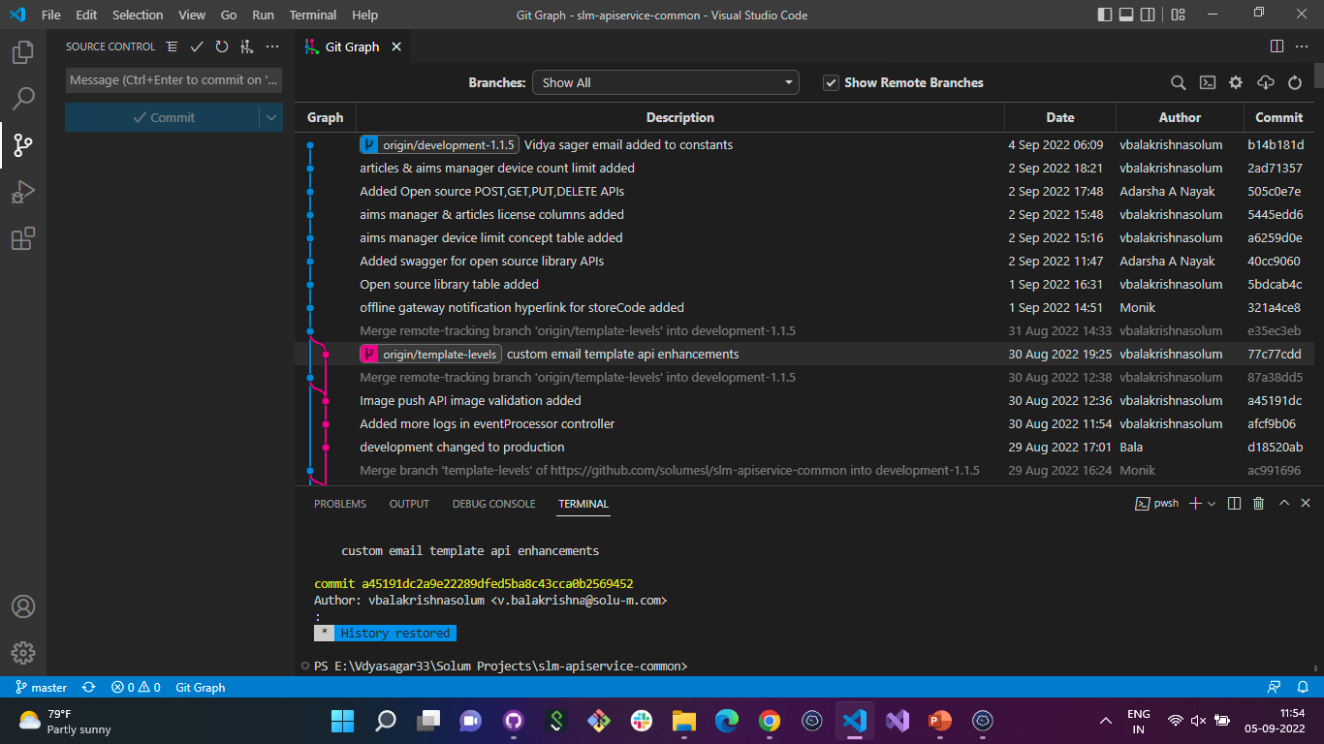
API Service Commits without Tags

Slide 9
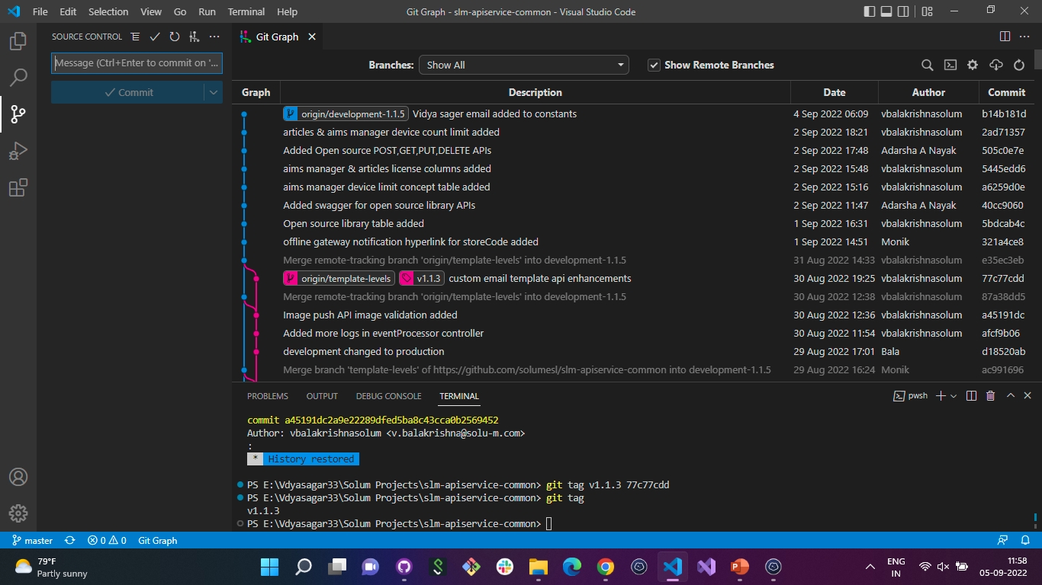
API Service Commits with Tags

Slide 10
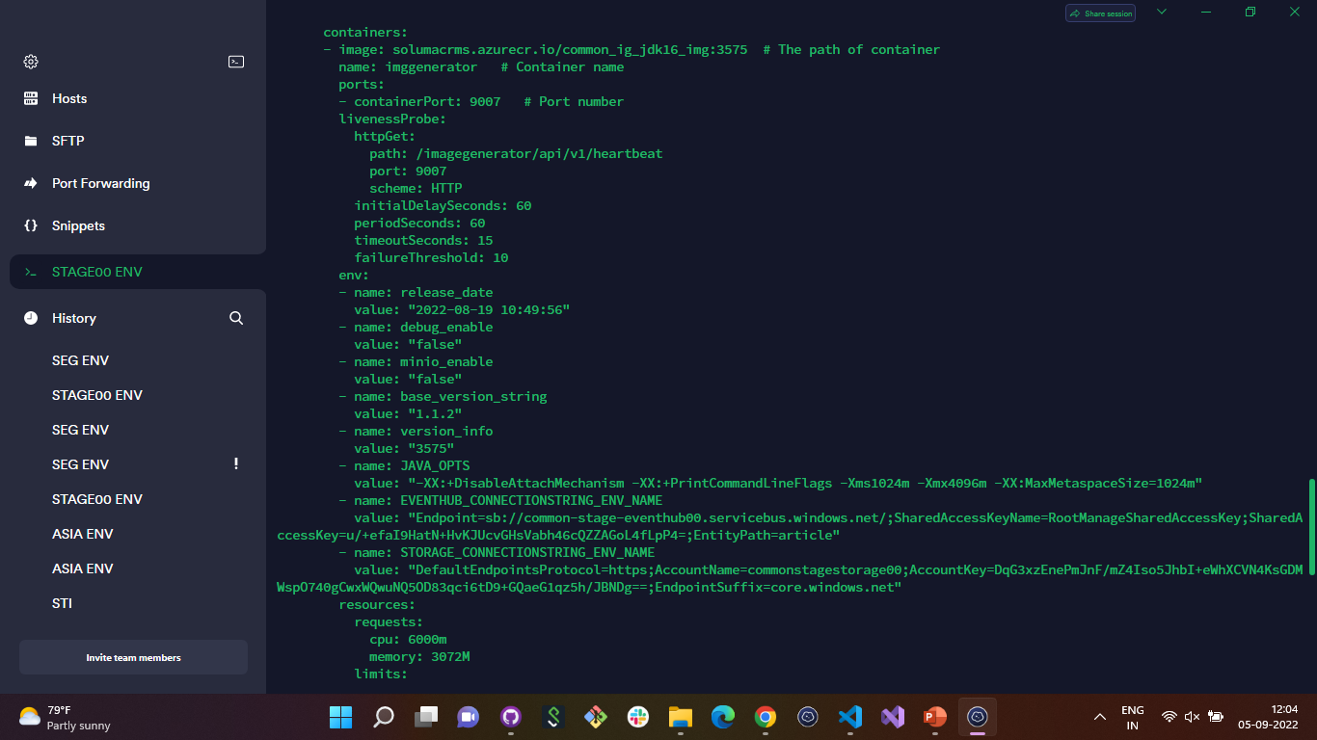
Image Generator YAML File

Slide 11
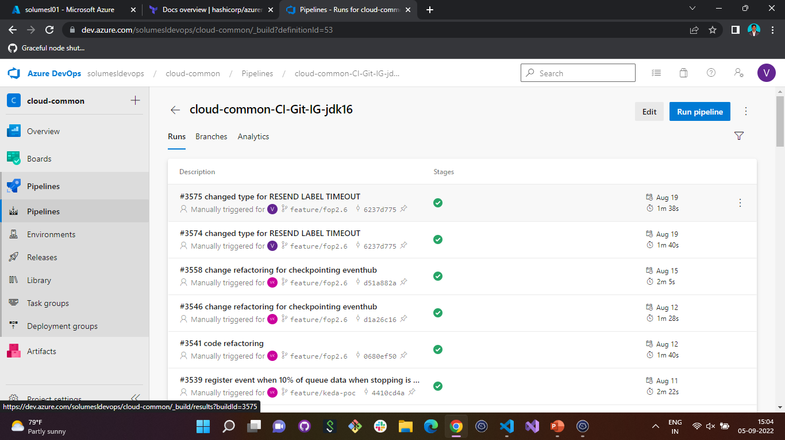
Azure Pipeline for Image Generator

Slide 12
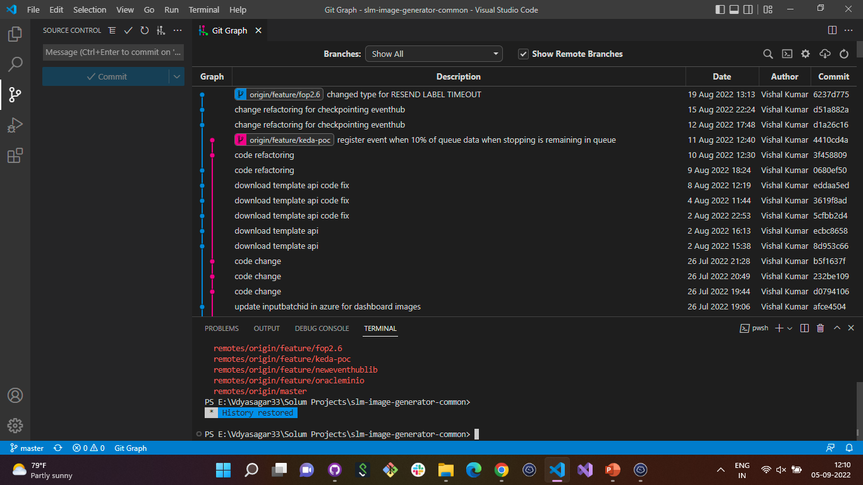
Image Generator Commits without Tags

Slide 13
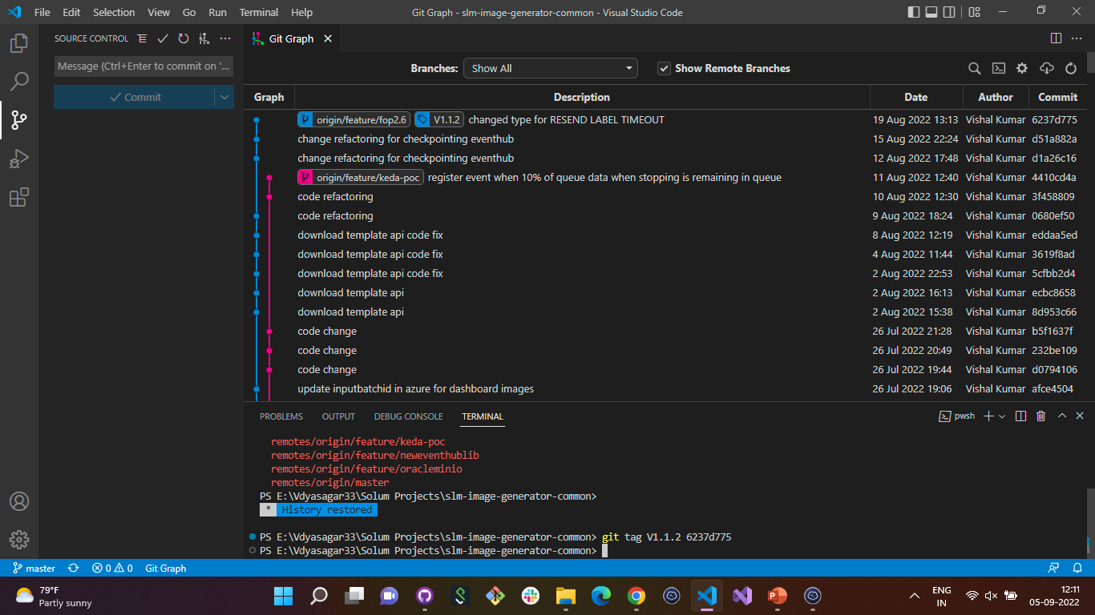
Image Generator Commits with Tags

Slide 14

THANK YOU

